Slide 1
P589-1: cefx downsampled to iar counts, new clustering options
Thomas H. Edwards
20241030

Slide 2
Downsampled cefx cells to equal the iar cell count for each donor
donorId | Microbial | IAR | Polyclonal
1_Control | 110 | 110 | 42
3_Control | 236 | 236 | 488
4_Control | 384 | 384 | 598
2_T1D | 152 | 152 | 159
5_T1D | 237 | 237 | 274
6_T1D | 244 | 244 | 435
Alex Hu did not downsample in P390—he excluded cells that were in the wrong cluster according to flow labeling.
Propensity score matching not yet implemented—these are random draws.

Slide 3
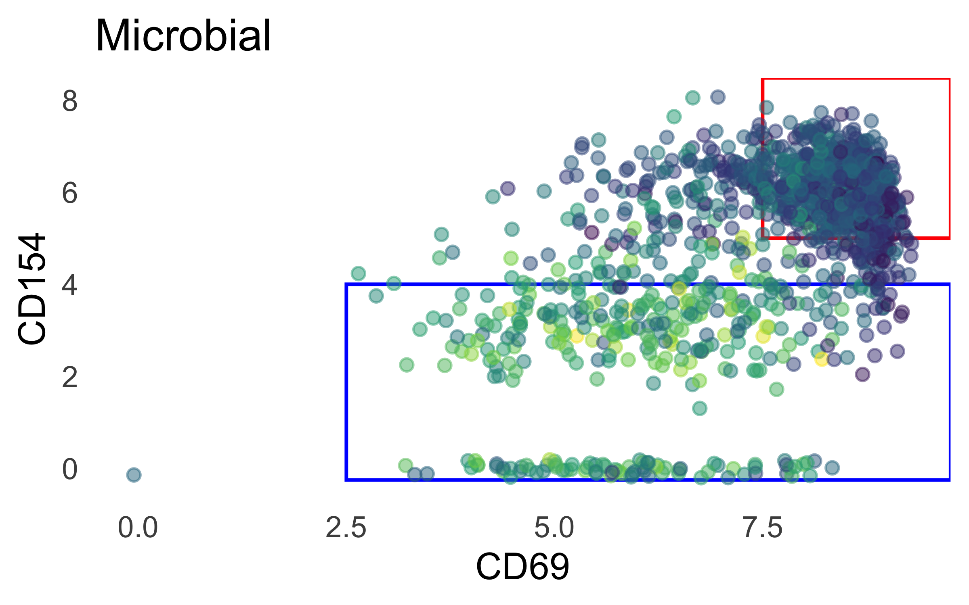
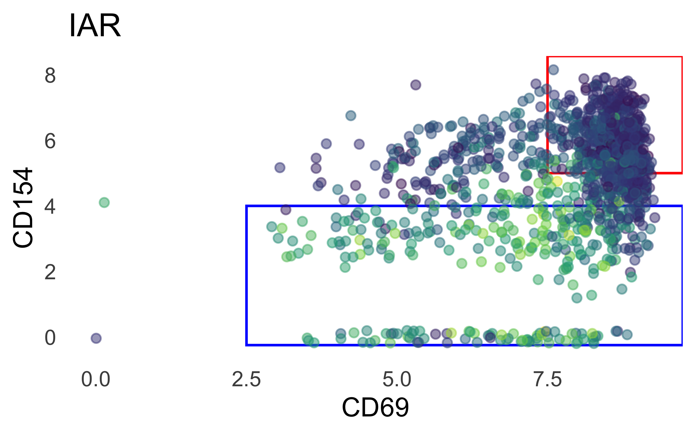
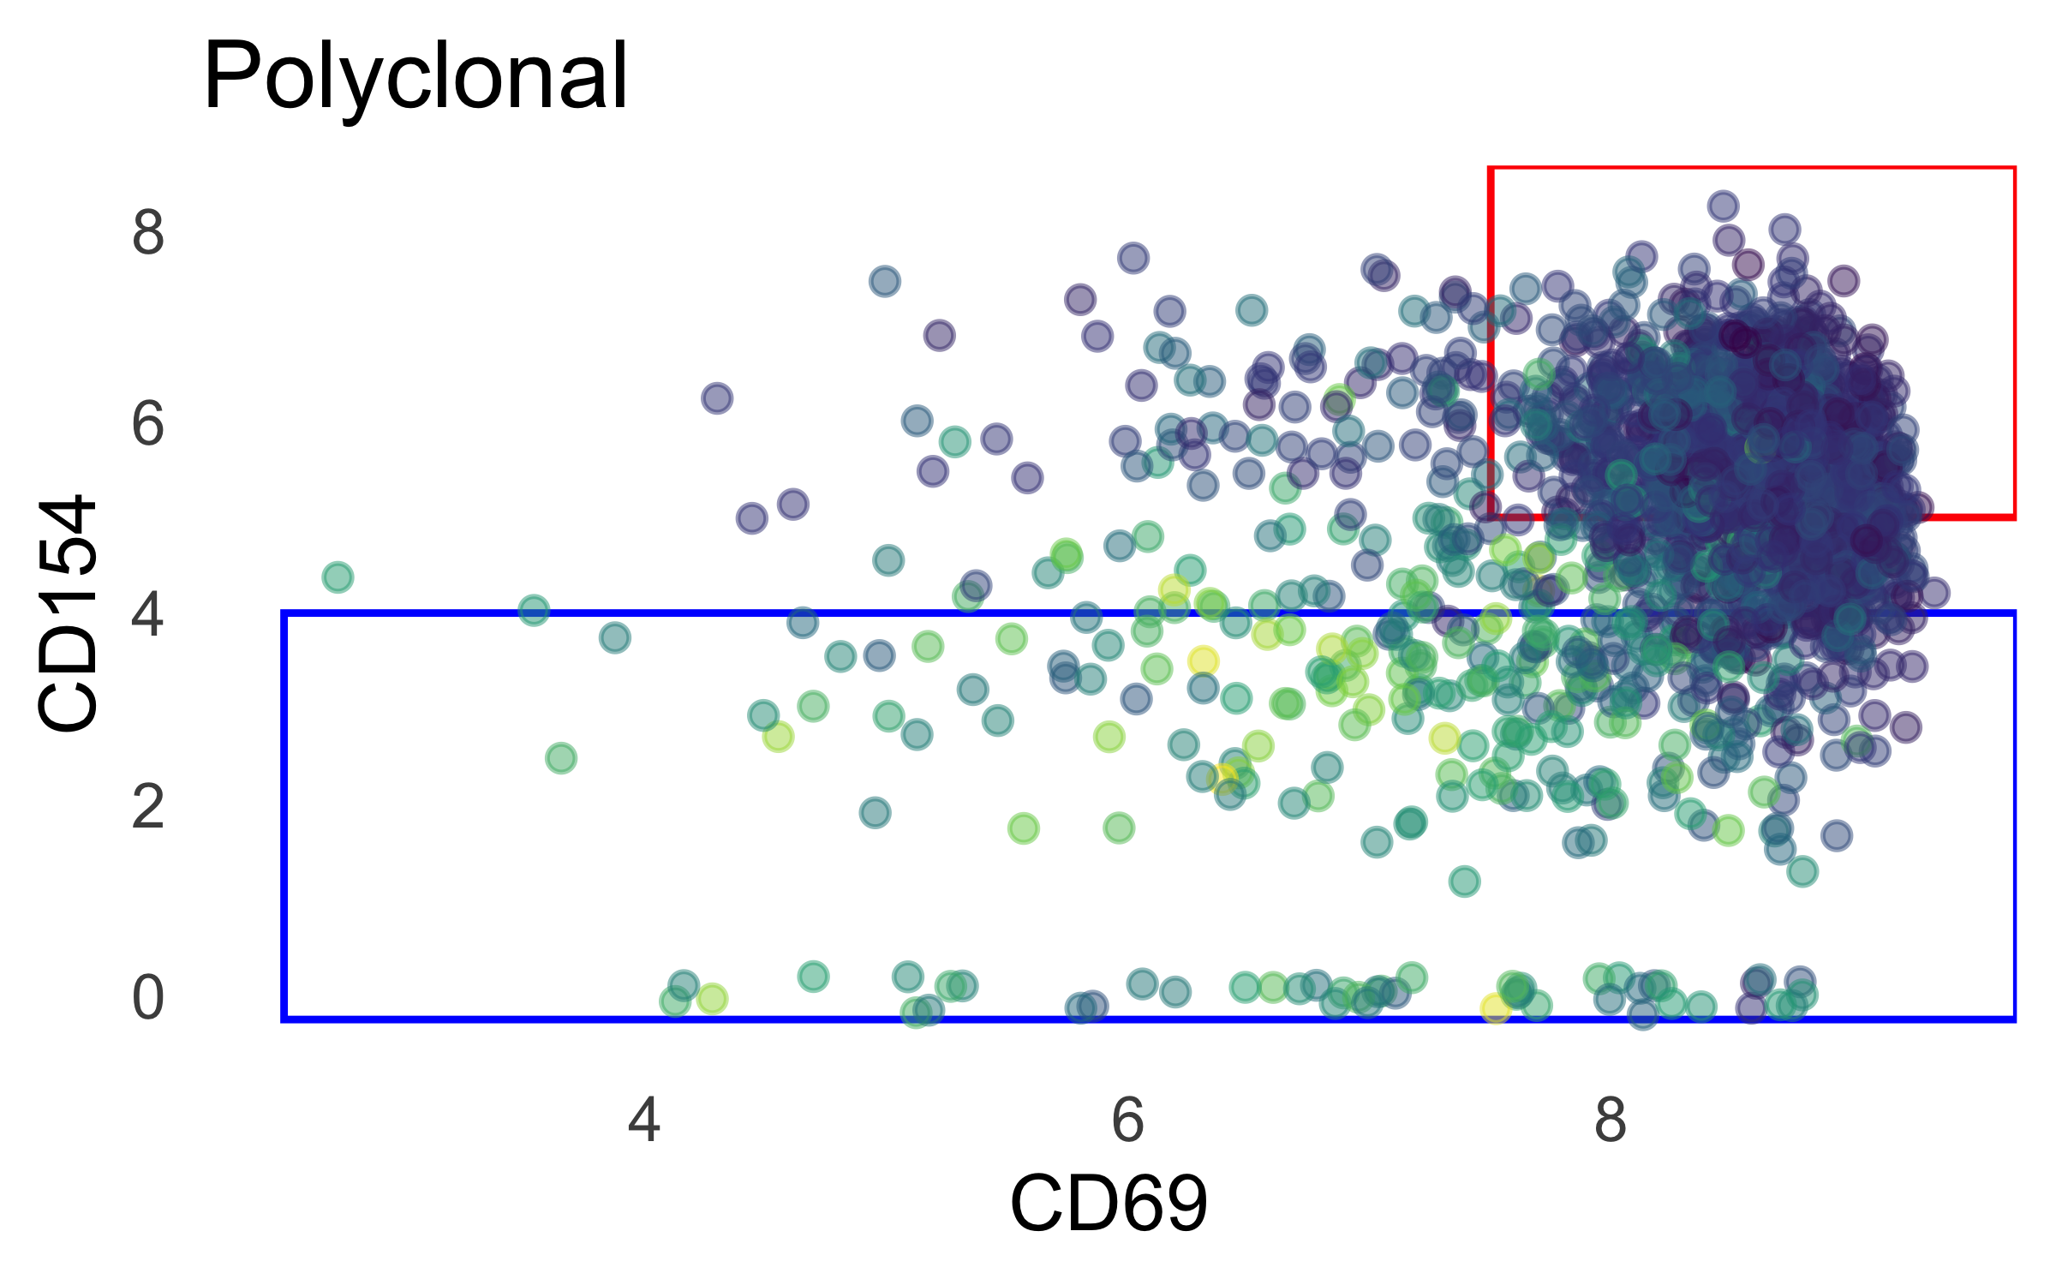
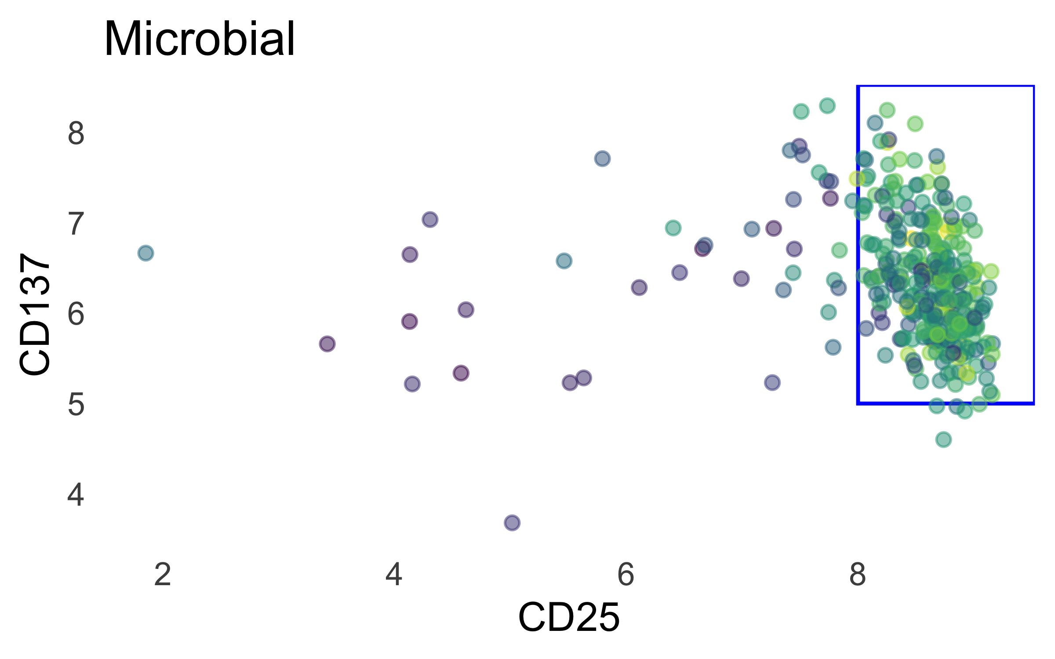
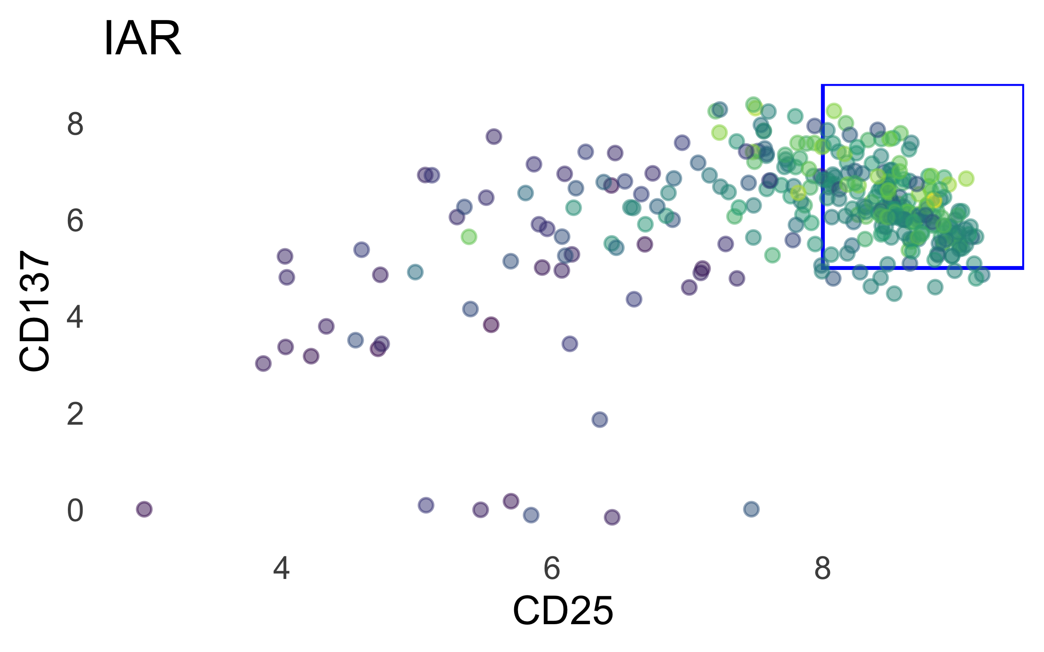
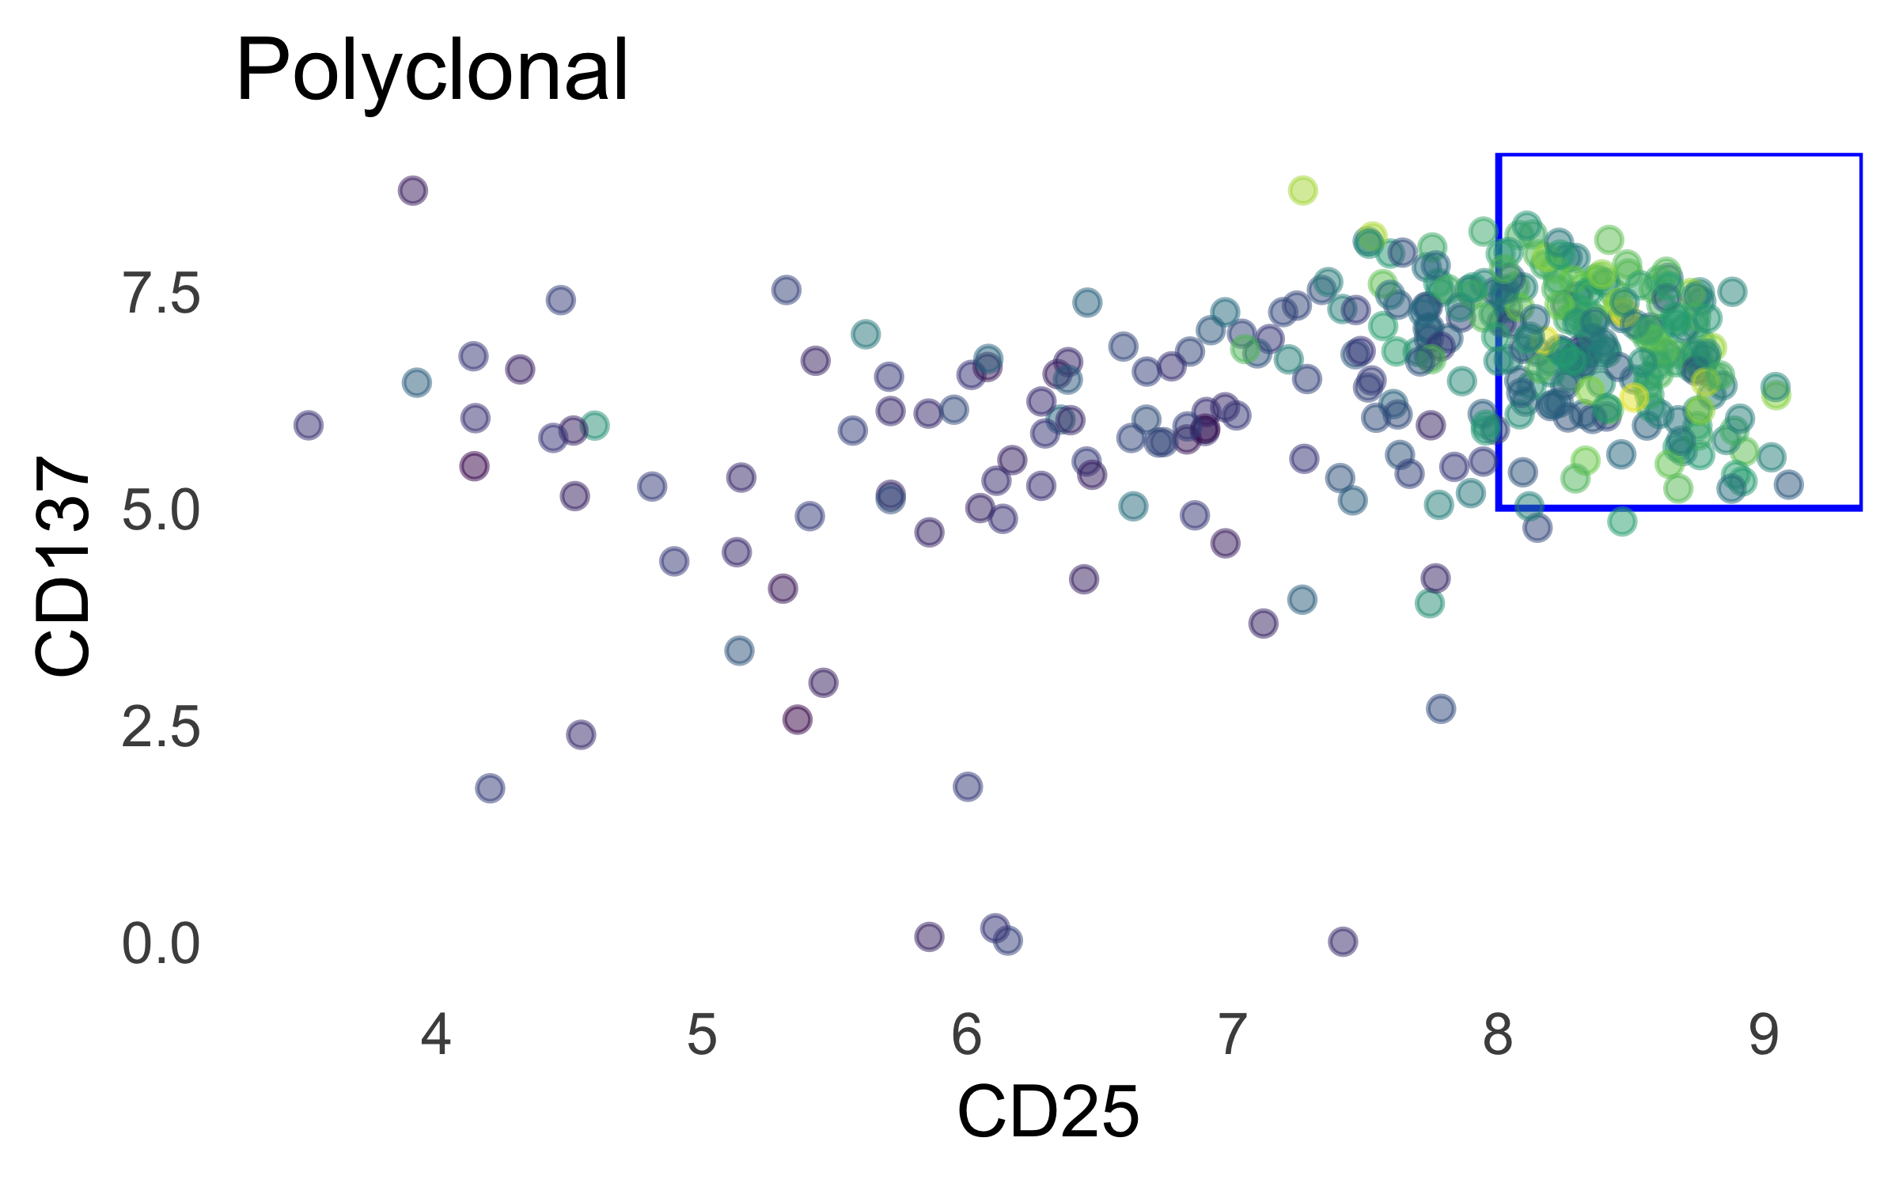
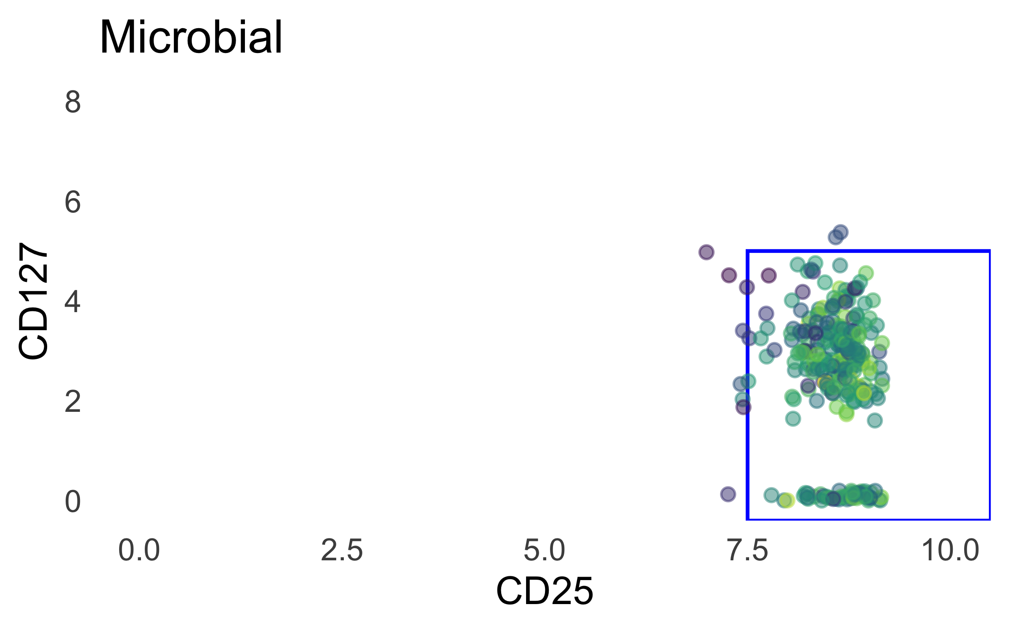
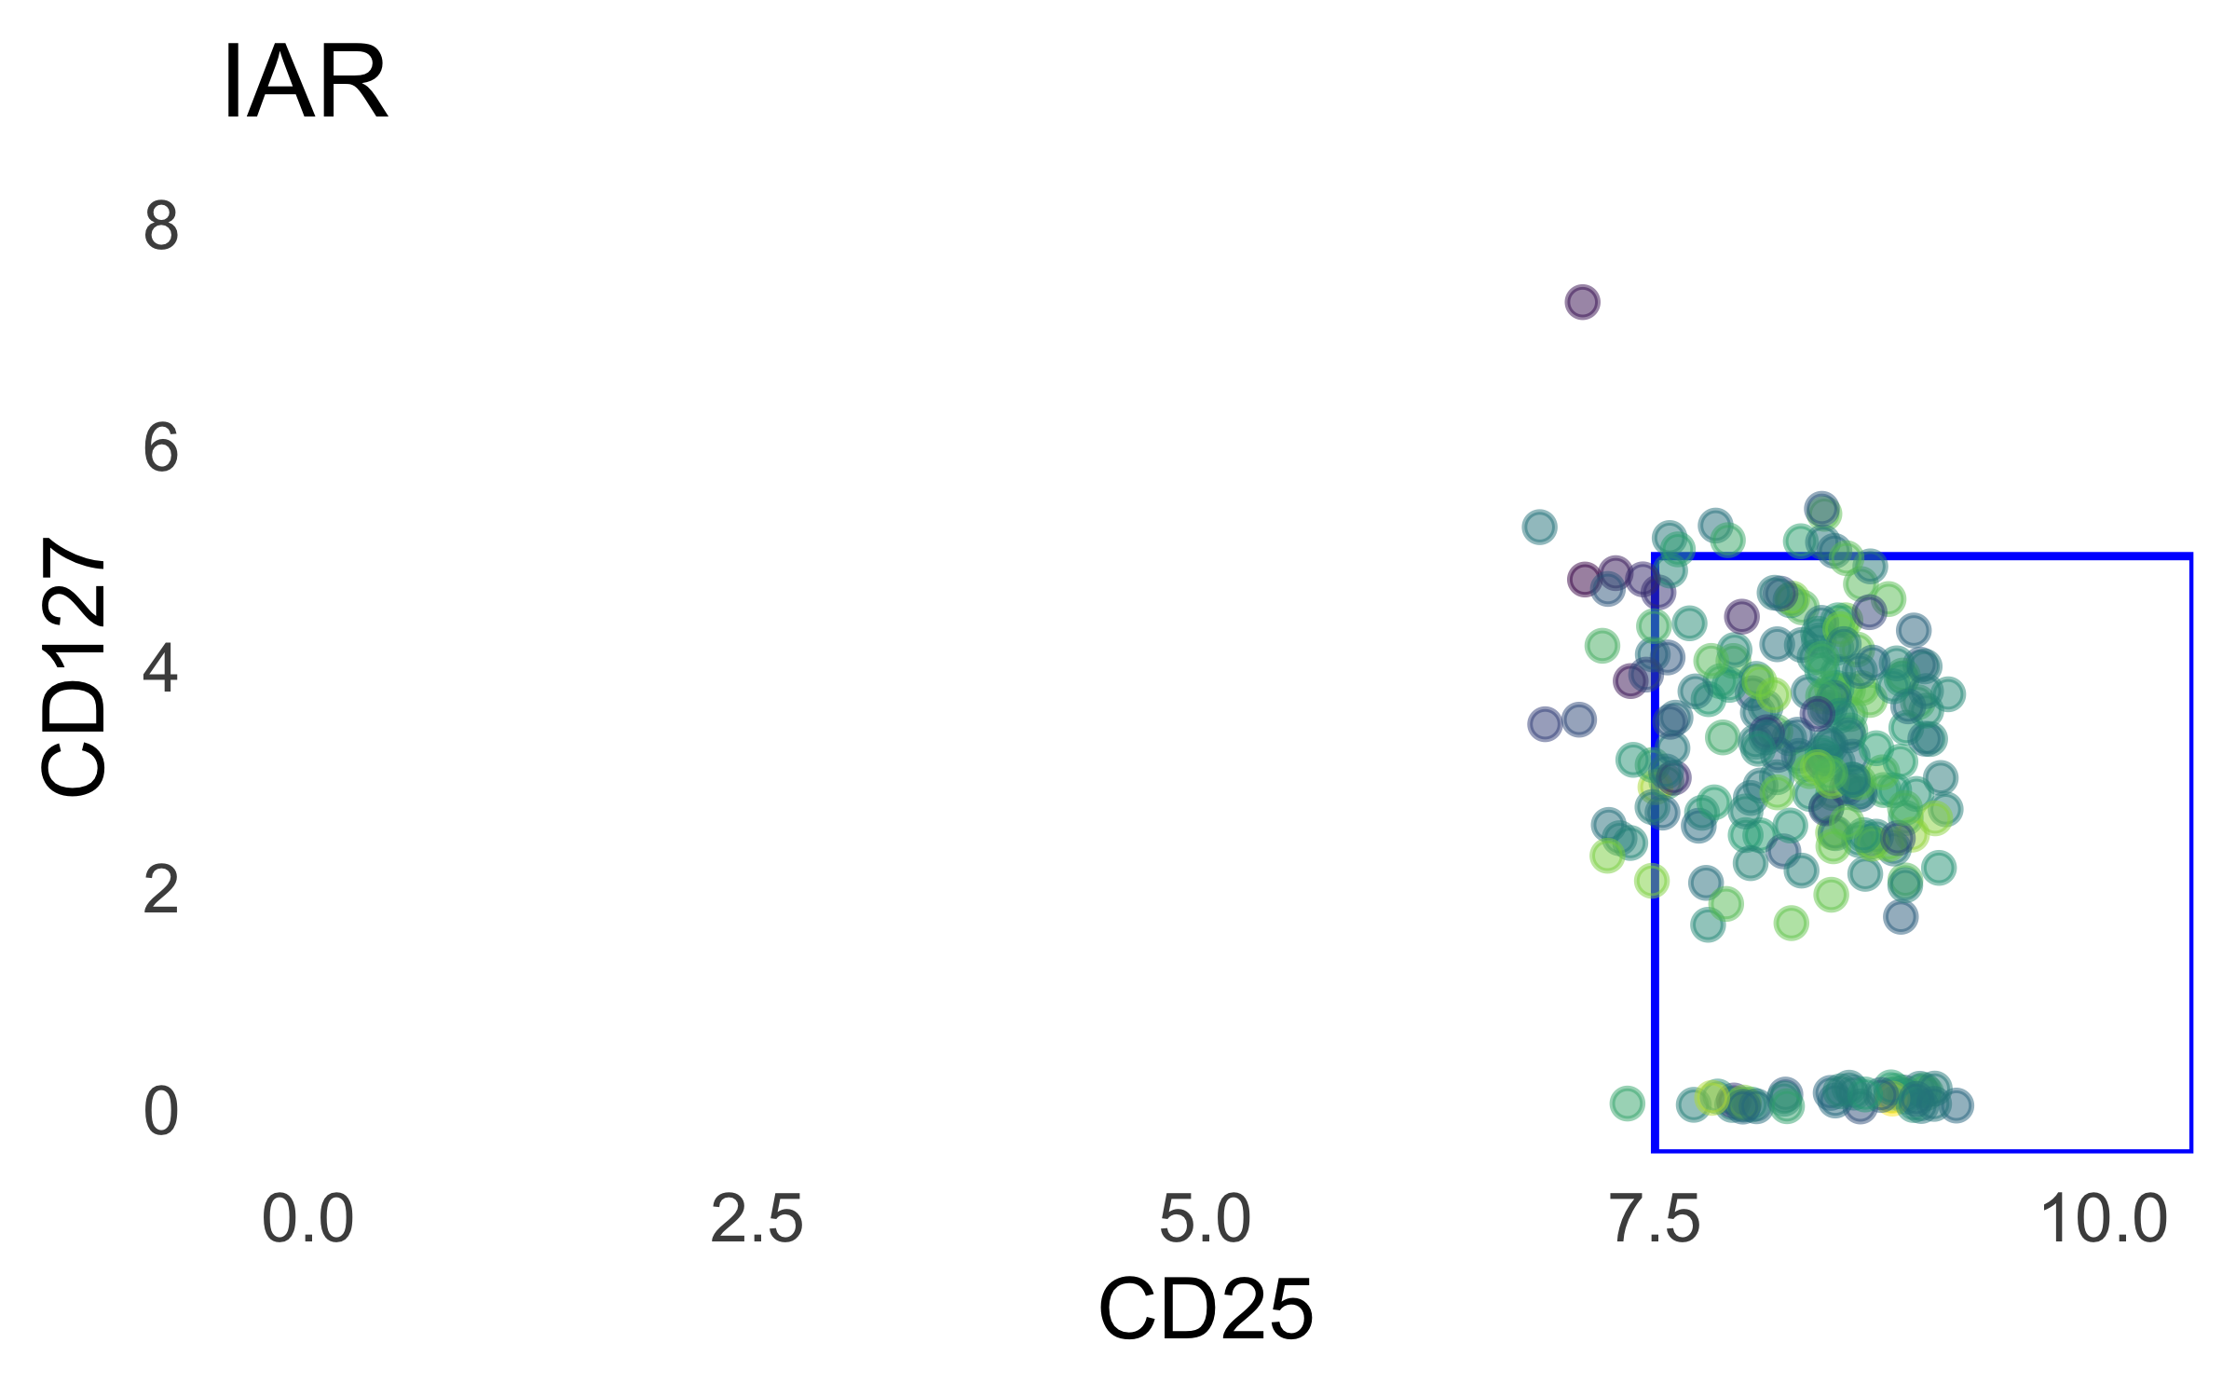
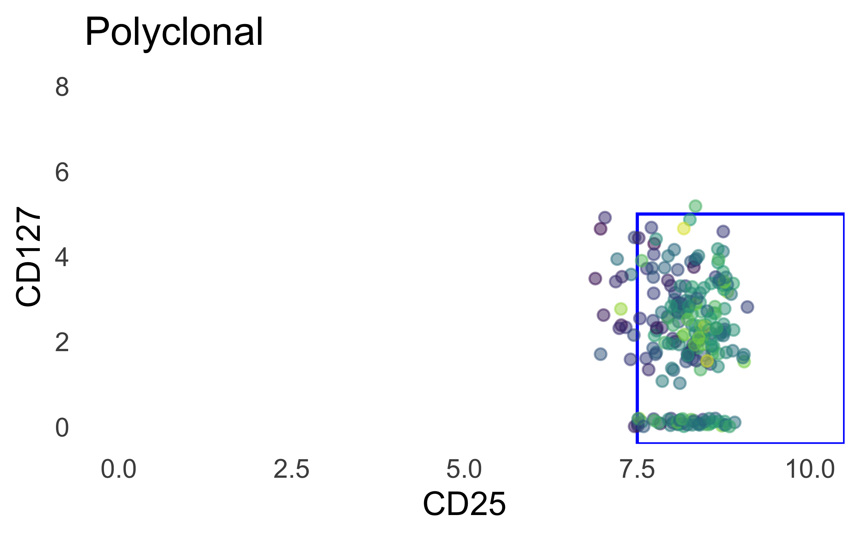
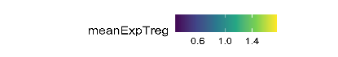
Totalseq gating: Tconv gate nudged up to 5, treg gate unchanged for now

Slide 4
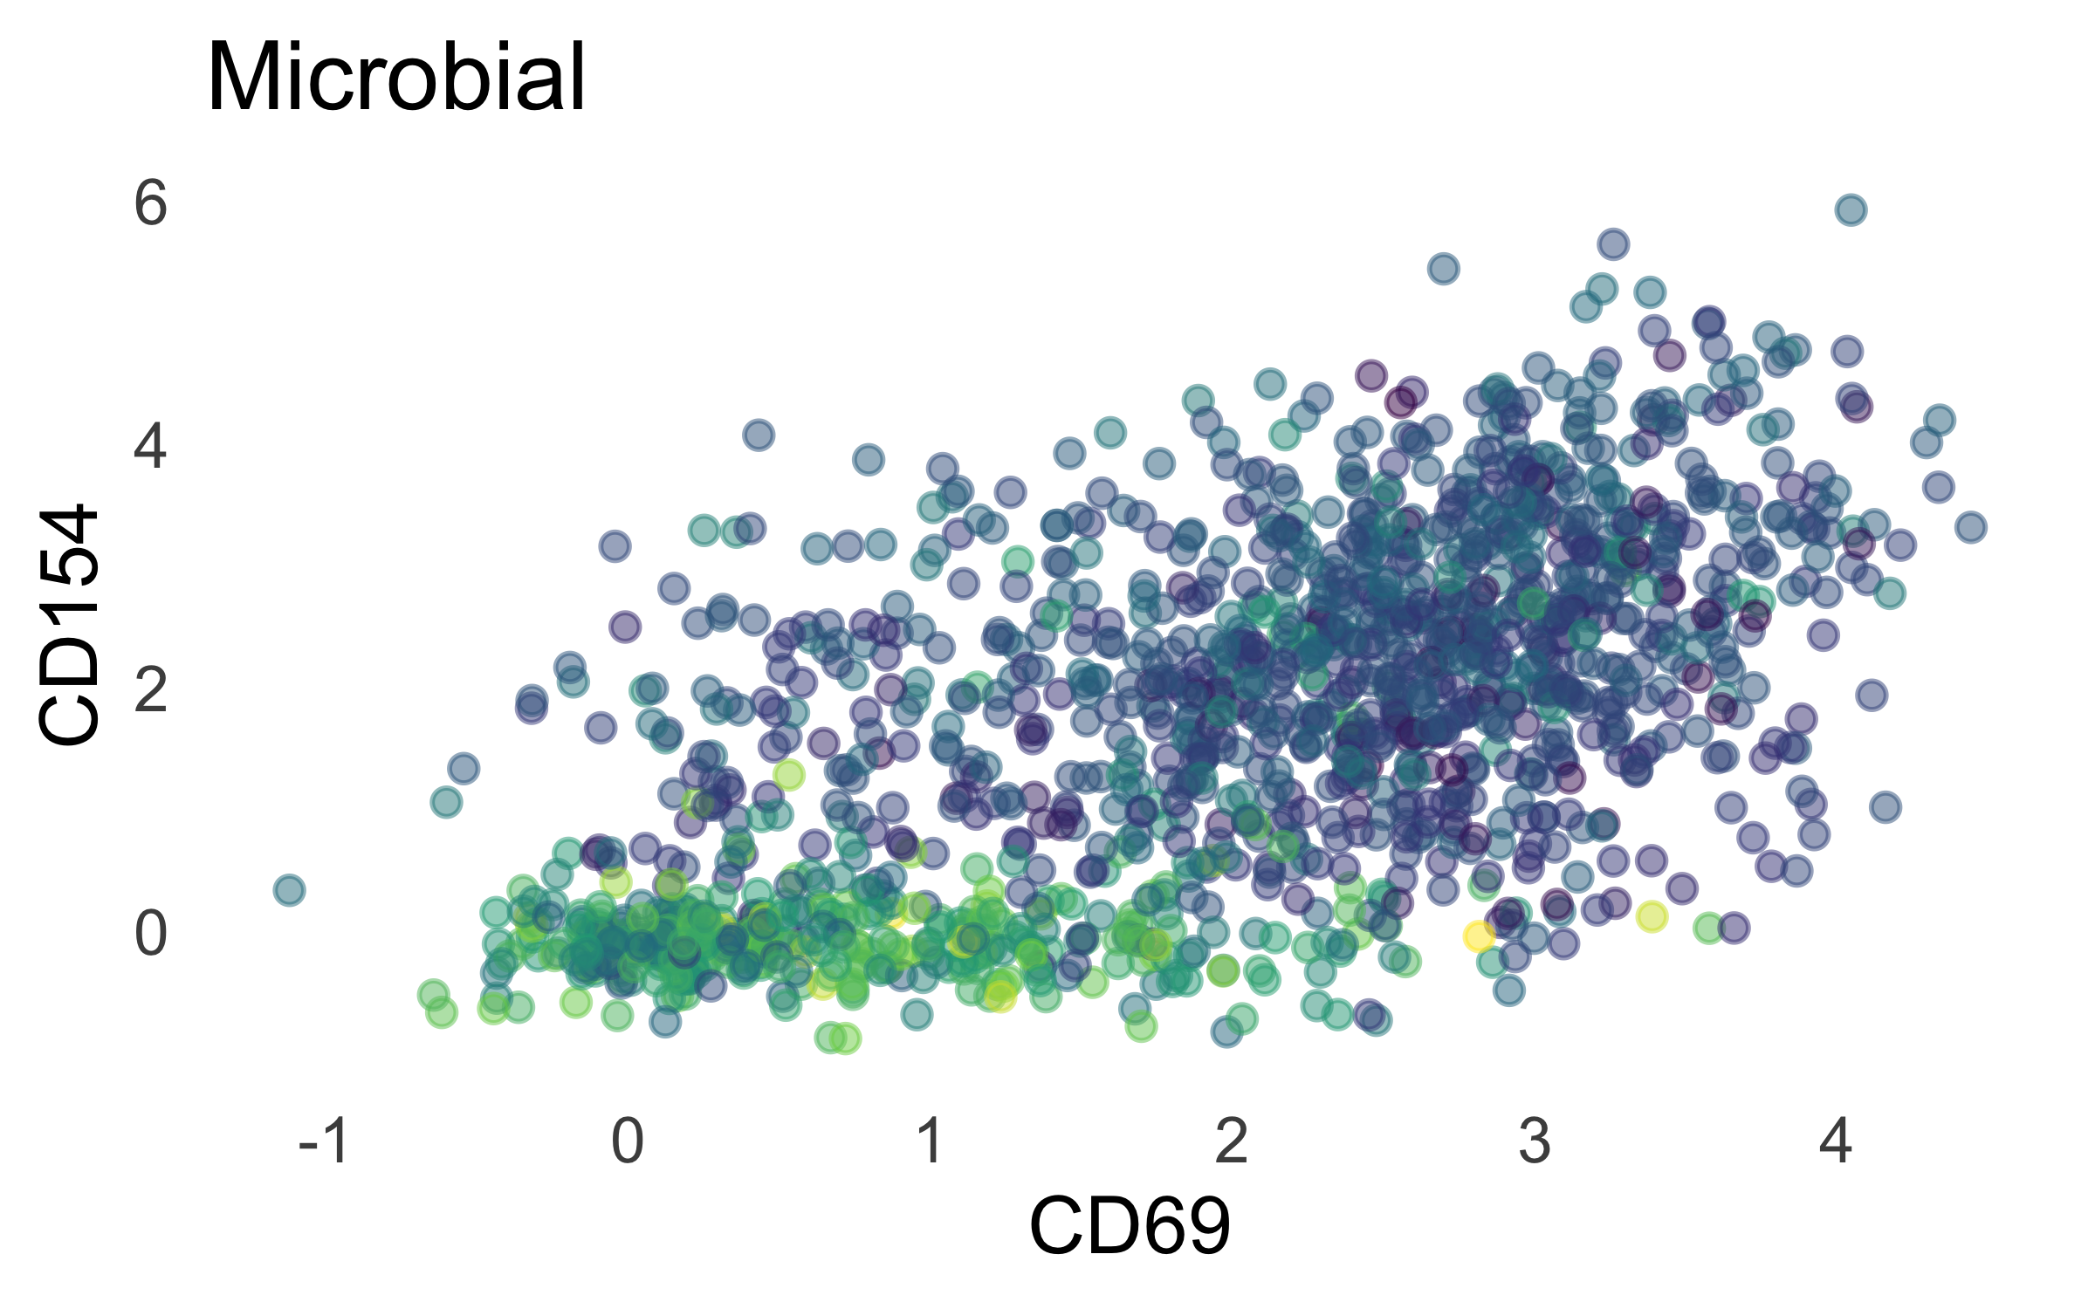
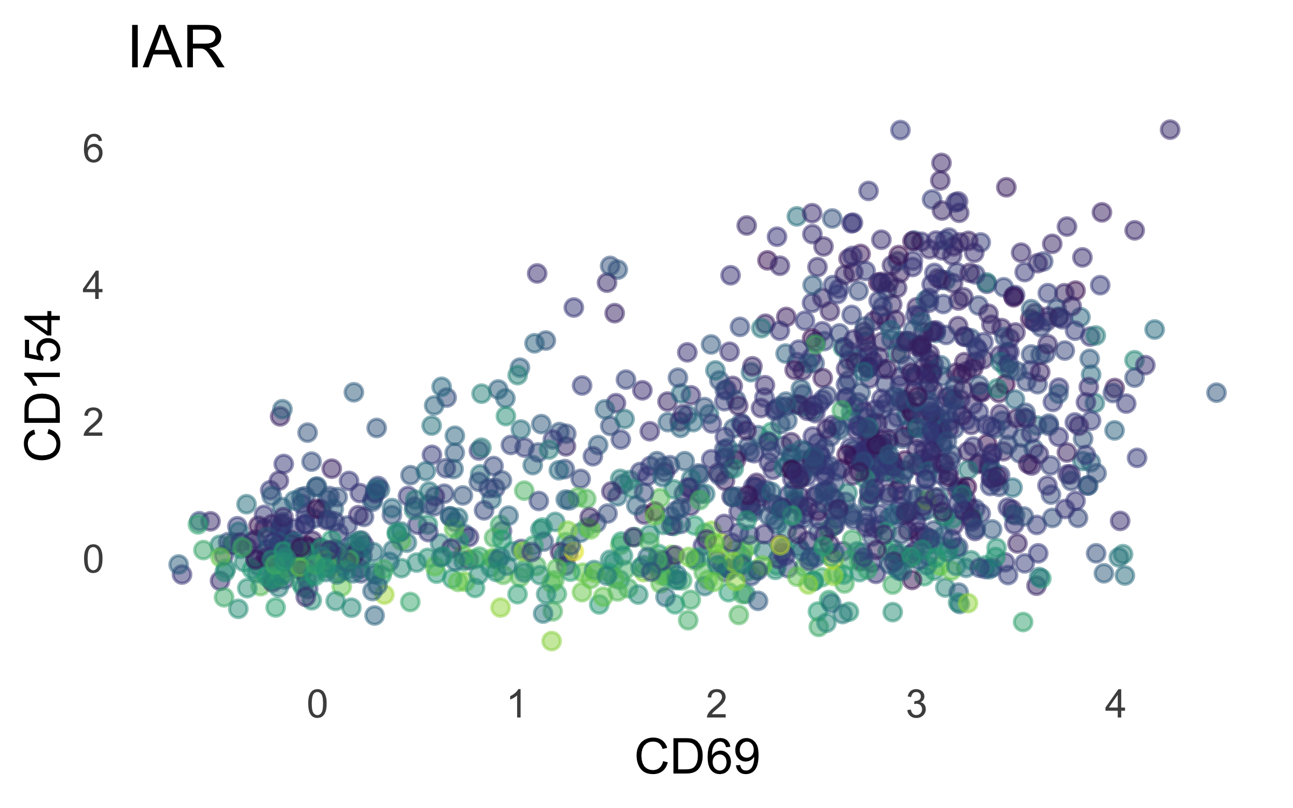
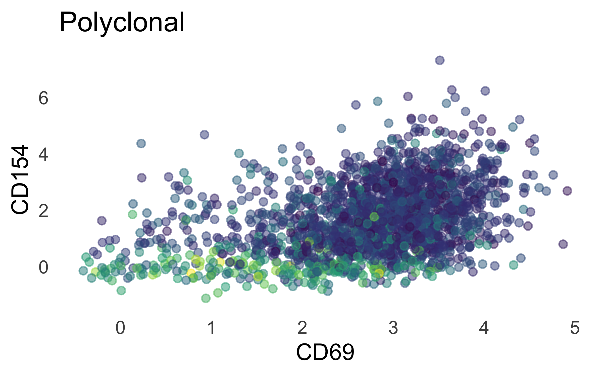
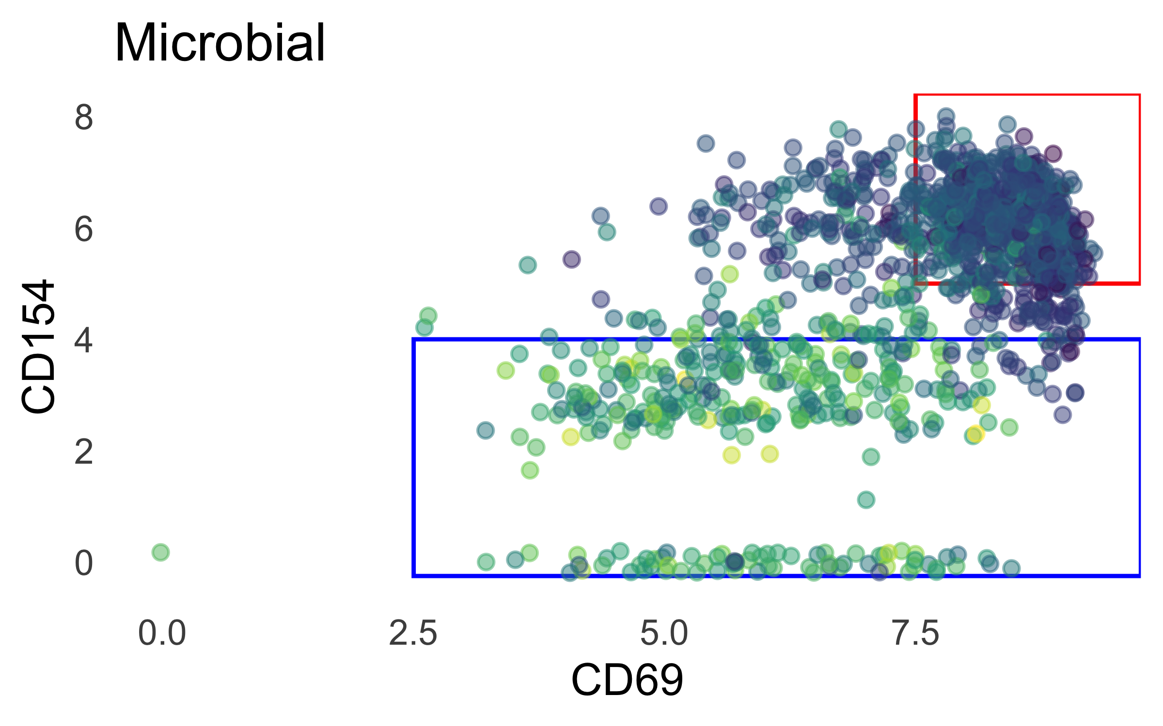
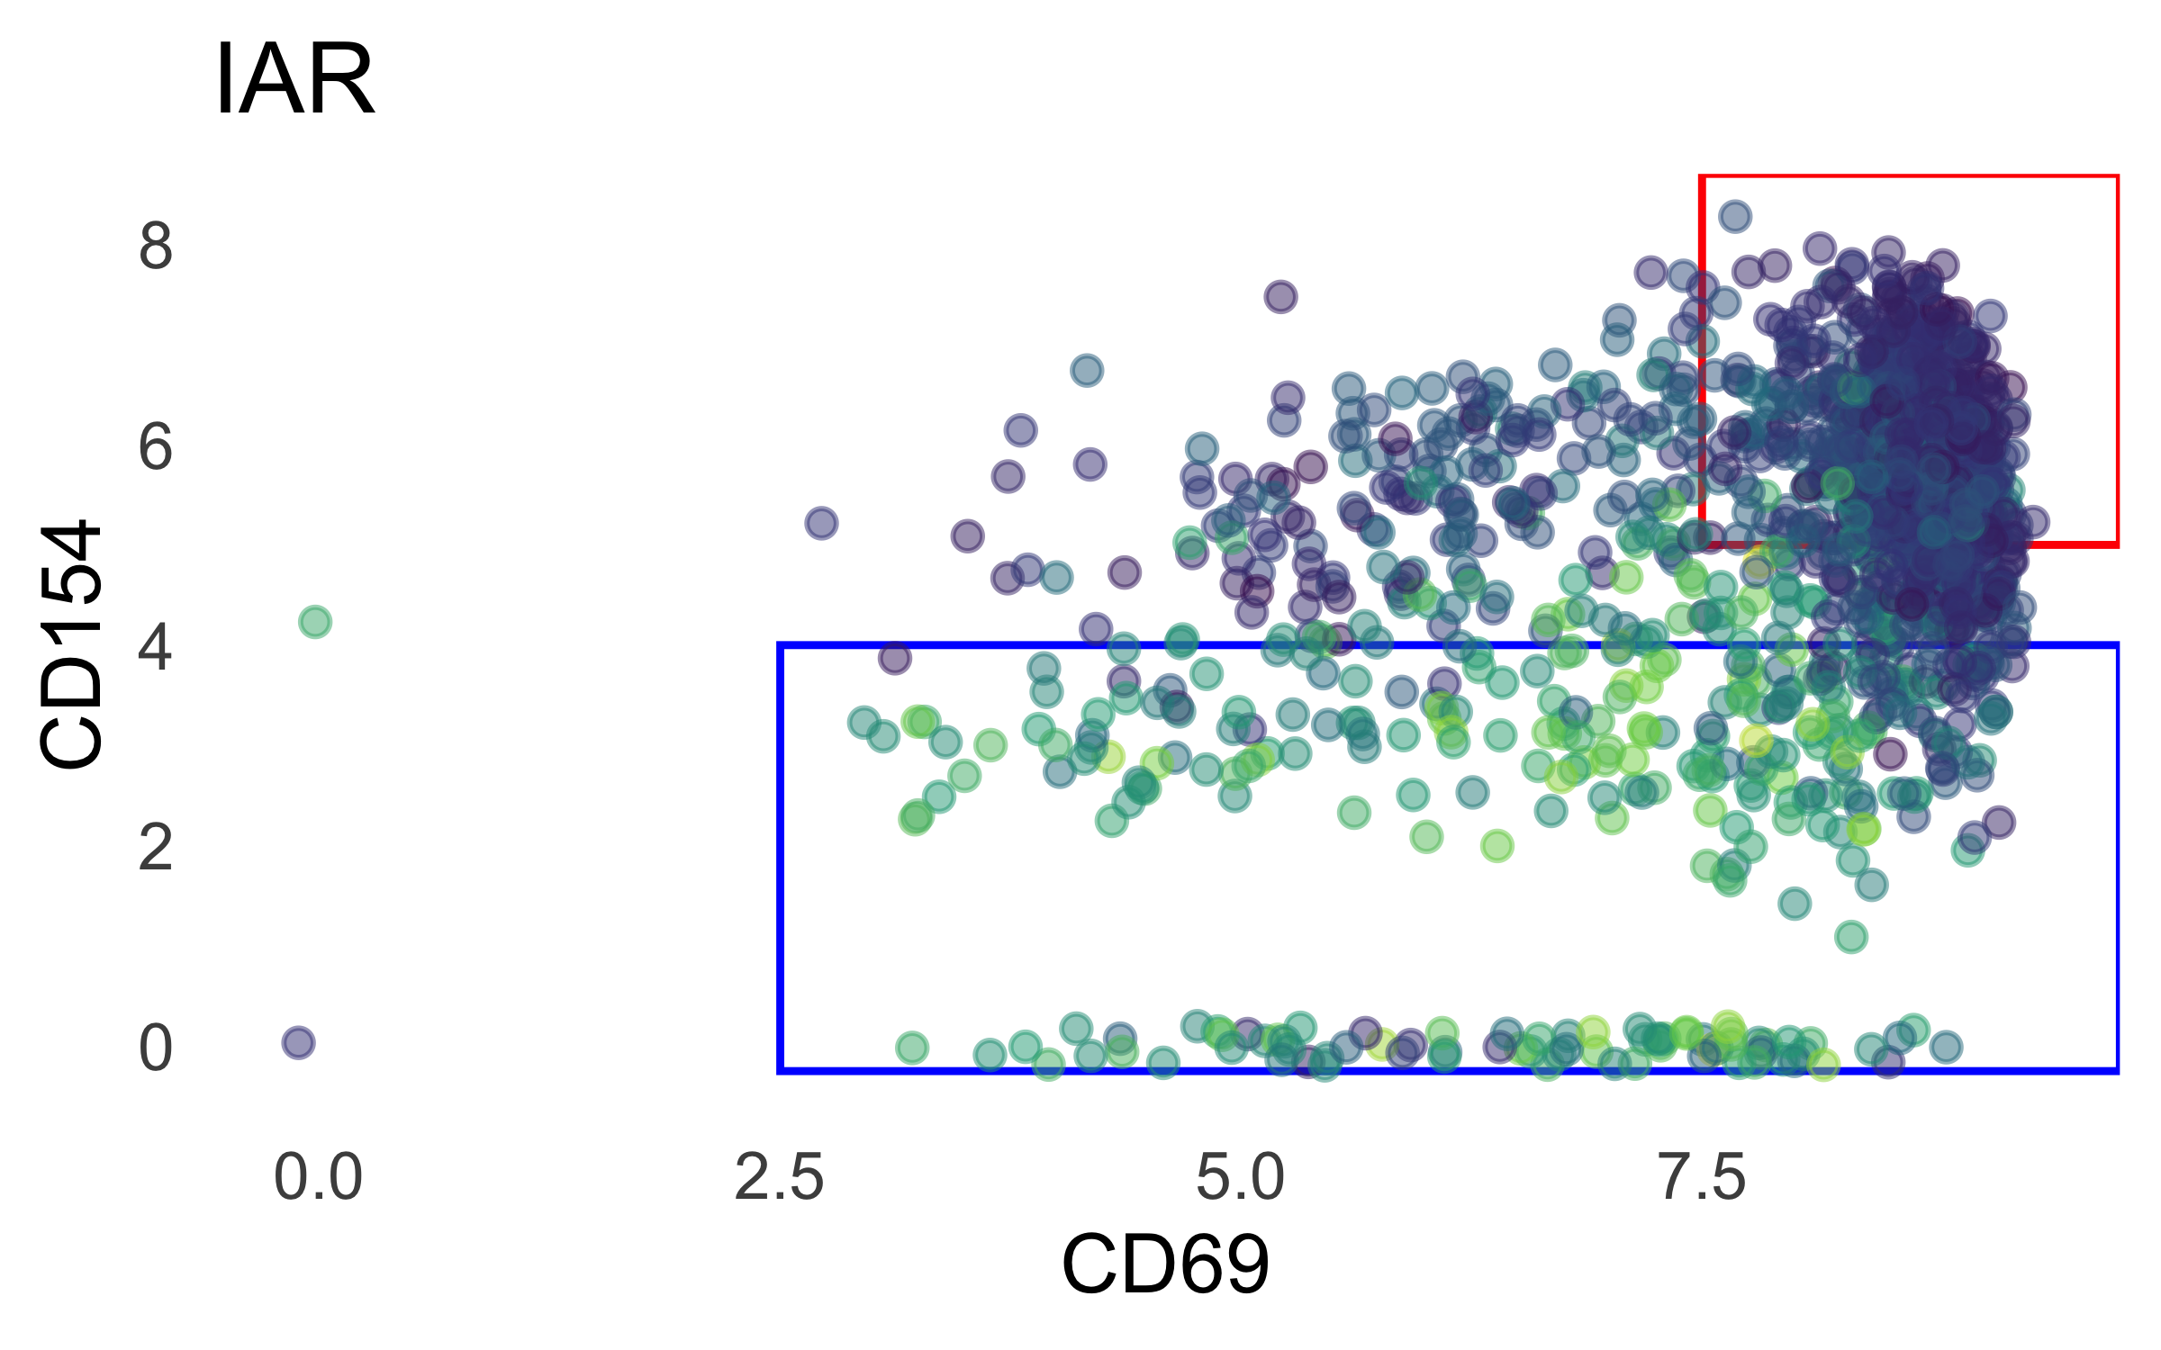

DSB and log-normalization comparison, P589-1 totalseq
DSB:
logNorm
Treg gene signature from P390

Slide 5
Treg/tconv ratios appear driven more by stim than studygroup
donorId | Microbial | IAR | Polyclonal | cellType
1_Control | 25 | 12 | 7 | Treg
3_Control | 35 | 32 | 58 | Treg
4_Control | 116 | 71 | 54 | Treg
2_T1D | 41 | 33 | 27 | Treg
5_T1D | 53 | 38 | 44 | Treg
6_T1D | 33 | 42 | 51 | Treg
1_Control | 67 | 85 | 30 | Tconv
3_Control | 178 | 155 | 349 | Tconv
4_Control | 168 | 213 | 496 | Tconv
2_T1D | 93 | 89 | 110 | Tconv
5_T1D | 146 | 126 | 190 | Tconv
6_T1D | 161 | 148 | 312 | Tconv
 | T1D_Treg | T1D_Tconv | HC_Treg | HC_Tconv
count | 362 | 1375 | 410 | 1741
% in studyGroup | 0.208 | 0.792 | 0.191 | 0.809
 | T1D_Treg_IAR | T1D_Tconv_IAR | HC_Treg_IAR | HC_Tconv_IAR
count | 113 | 363 | 115 | 453
% in studyGroup | 0.237 | 0.763 | 0.202 | 0.798
 | T1D_Treg_poly | T1D_Tconv_poly | HC_Treg_poly | HC_Tconv_poly
count | 122 | 612 | 119 | 875
% in studyGroup | 0.166 | 0.834 | 0.120 | 0.880
 | T1D_Treg_CEFX | T1D_Tconv_CEFX | HC_Treg_CEFX | HC_Tconv_CEFX
count | 127 | 400 | 176 | 413
% in studyGroup | 0.241 | 0.759 | 0.299 | 0.701

Slide 6
optimized 7-cluster option
Mean scaled cluster eval metric = 0.647/1 (DB, CH, and med. sil. score)

Slide 7
7-cluster, stimulation facet

Slide 8
Mean p390 module expression

Slide 9
Celltypist cell calling

Slide 10
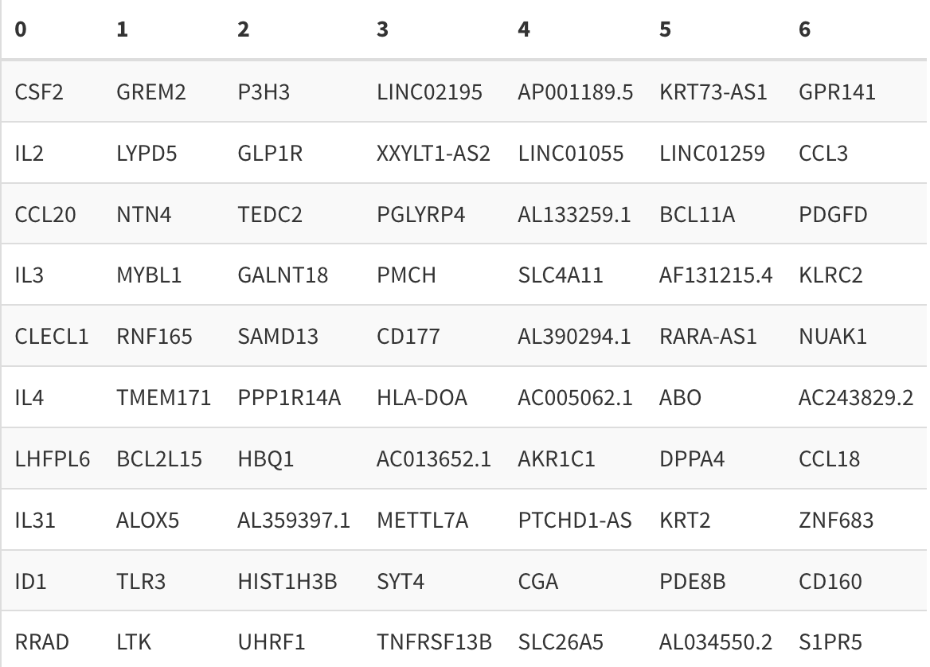
Top 10 cluster-defining genes
Top 10 cluster-defining genes (up relative to other clusters)

Slide 11
Top 10 cluster-defining genes dotplot & diversity metric

Slide 12
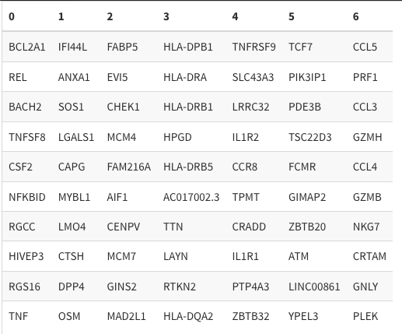
Top 10 cluster-defining genes
Top 10 cluster-defining genes (up relative to other clusters, expressed in at least 30% of cells in that cluster)

Slide 13
Top 10 cluster-defining genes dotplot & diversity metric

Slide 14
Optimized 5-cluster option
Mean scaled cluster eval metric = 0.801/1 (DB, CH, and med. sil. score)

Slide 15
5-cluster, stimulation facet

Slide 16
Mean p390 module expression

Slide 17
Celltypist cell calling

Slide 18
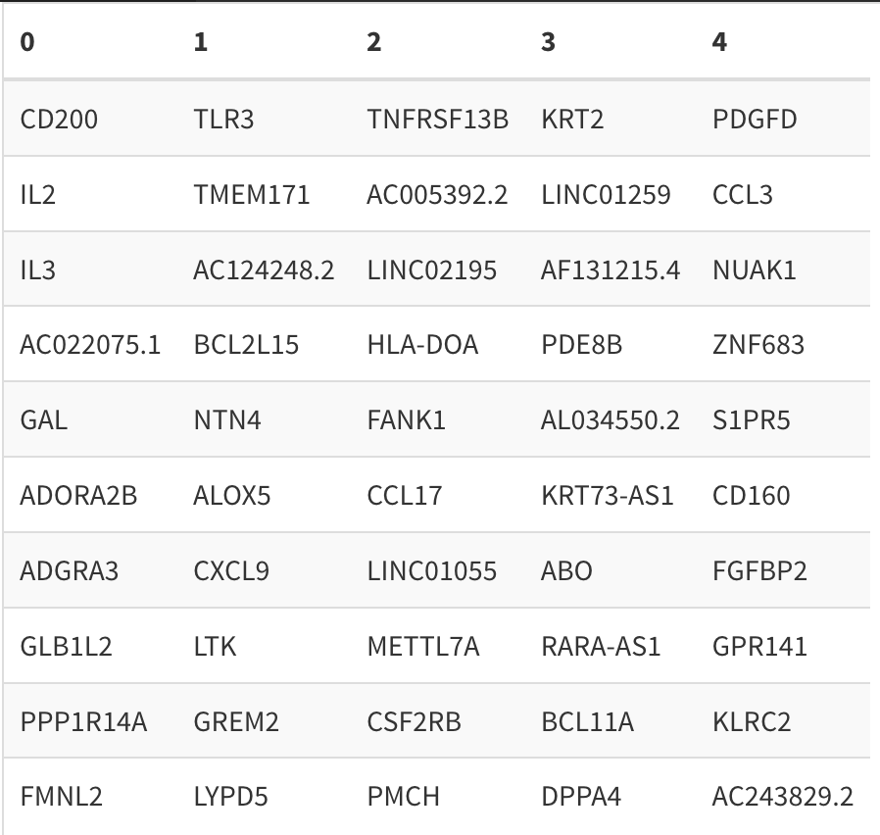
Top 10 cluster-defining genes
Top 10 cluster-defining genes (up relative to other clusters)

Slide 19
Top 10 cluster-defining genes dotplot & diversity metric

Slide 20
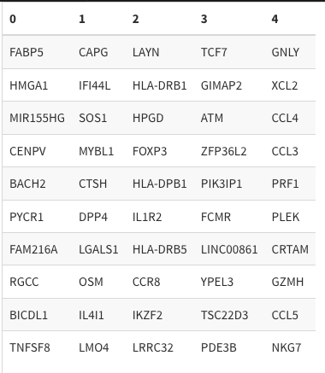
Top 10 cluster-defining genes
Top 10 cluster-defining genes (up relative to other clusters, only genes expressed in at least 30% of cells in that cluster)

Slide 21
Top 10 cluster-defining genes dotplot & diversity metric

Slide 22
optimized 3-cluster option
Mean scaled cluster eval metric = 0.937/1 (DB, CH, and med. sil. score)

Slide 23
3-cluster, stimulation facet

Slide 24
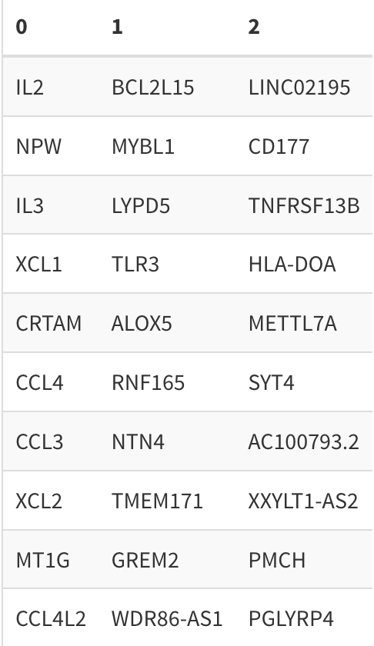
Top 10 cluster-defining genes
Top 10 cluster-defining genes (up relative to other clusters)

Slide 25
Top 10 cluster-defining genes dotplot & diversity metric

Slide 26
Mean p390 module expression

Slide 28
Optimized 4-cluster option
Mean scaled cluster eval metric = 0.817/1 (DB, CH, and med. sil. score)

Slide 29
4-cluster, stimulation facet

Slide 30
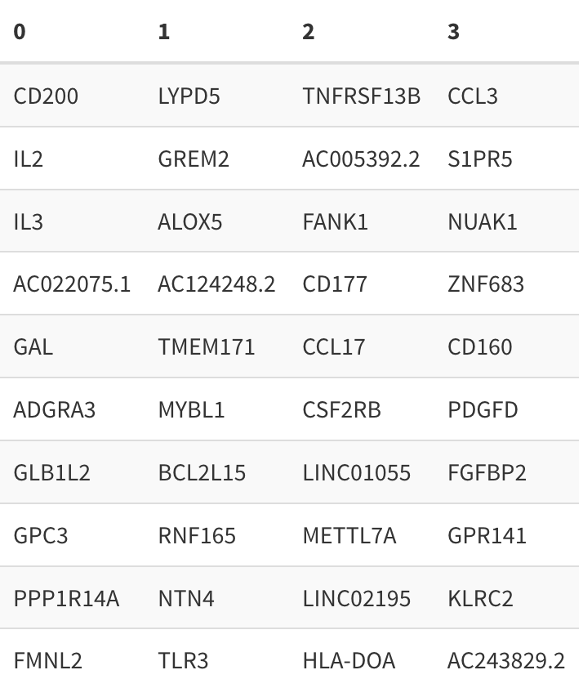
Top 10 cluster-defining genes
Top 10 cluster-defining genes (up relative to other clusters)

Slide 31
Top 10 cluster-defining genes dotplot & diversity metric

Slide 32
Mean p390 module expression

Slide 33
Celltypist cell calling

Slide 34
optimized 6-cluster option
Mean scaled cluster eval metric = 0.571/1 (DB, CH, and med. sil. score)

Slide 35
6-cluster, stimulation facet

Slide 36
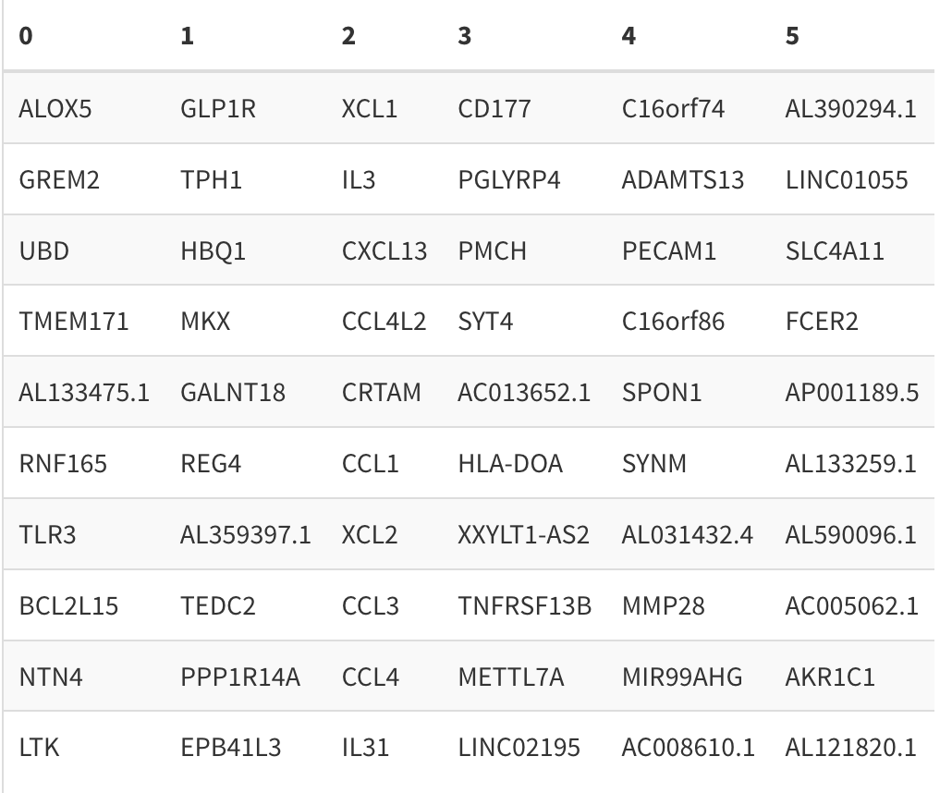
Top 10 cluster-defining genes
Top 10 cluster-defining genes (up relative to other clusters)

Slide 37
Top 10 cluster-defining genes dotplot & diversity metric

Slide 38
Mean p390 module expression

Slide 39
Celltypist cell calling

Slide 40
optimized 8-cluster option
Mean scaled cluster eval metric = 0.602/1 (DB, CH, and med. sil. score)

Slide 41
8-cluster, stimulation facet

Slide 42
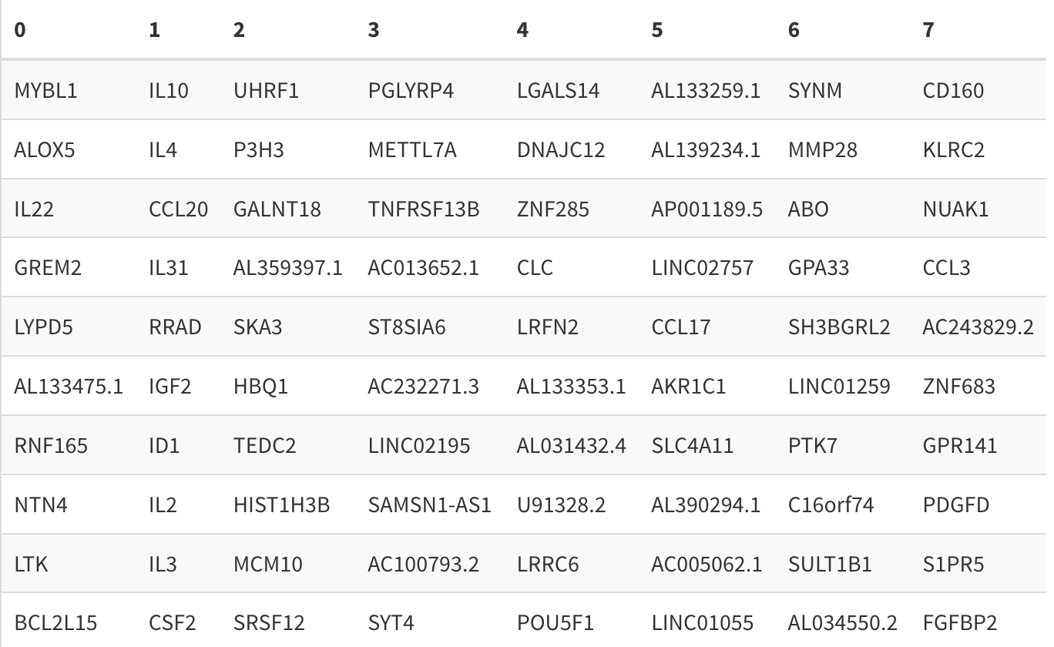
Top 10 cluster-defining genes
Top 10 cluster-defining genes (up relative to other clusters)

Slide 43
Top 10 cluster-defining genes dotplot & diversity metric

Slide 44
Mean p390 module expression

Slide 45
Celltypist cell calling

Slide 46
optimized 9-cluster option
Mean scaled cluster eval metric = 0.519/1 (DB, CH, and med. sil. score)

Slide 47
9-cluster, stimulation facet

Slide 48
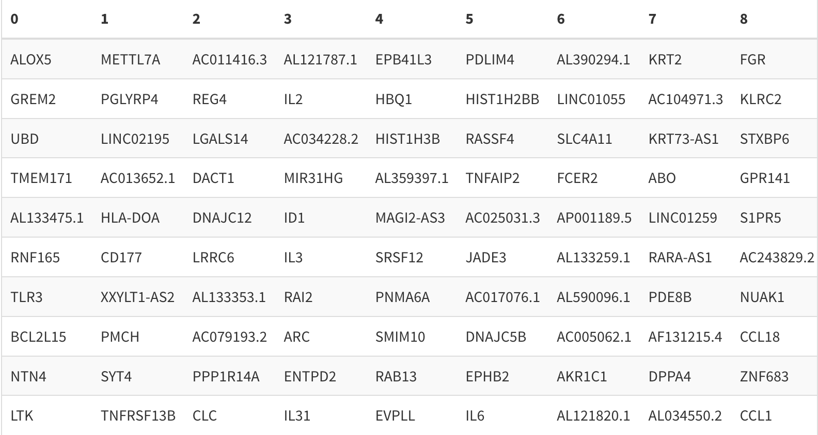
Top 10 cluster-defining genes
Top 10 cluster-defining genes (up relative to other clusters)

Slide 49
Top 10 cluster-defining genes dotplot & diversity metric

Slide 50
Mean p390 module expression

Slide 51
Celltypist cell calling

Slide 52
optimized 10-cluster option
Mean scaled cluster eval metric = 0.379/1 (DB, CH, and med. sil. score)

Slide 53
10-cluster, stimulation facet

Slide 54
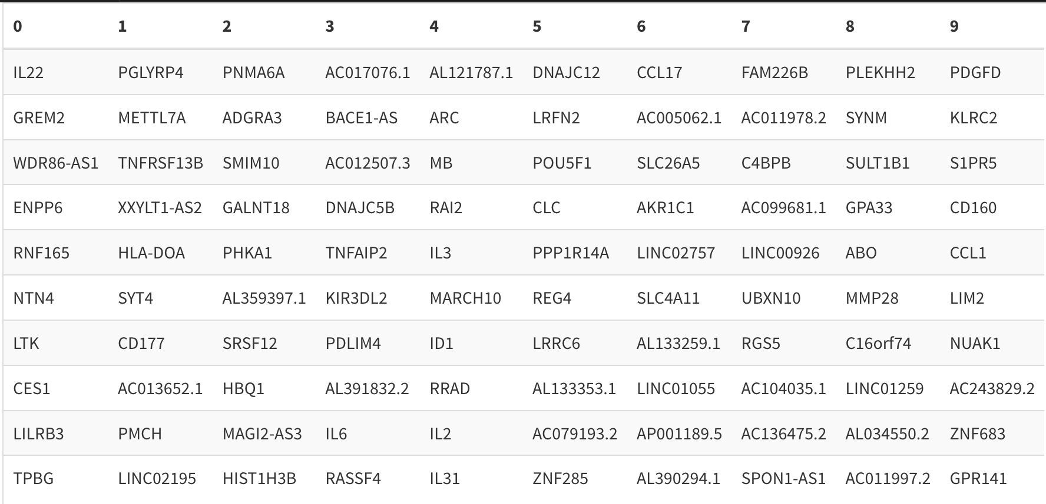
Top 10 cluster-defining genes
Top 10 cluster-defining genes (up relative to other clusters)

Slide 55
Top 10 cluster-defining genes dotplot & diversity metric

Slide 56
Mean p390 module expression

Slide 57
Celltypist cell calling

